Slide 1
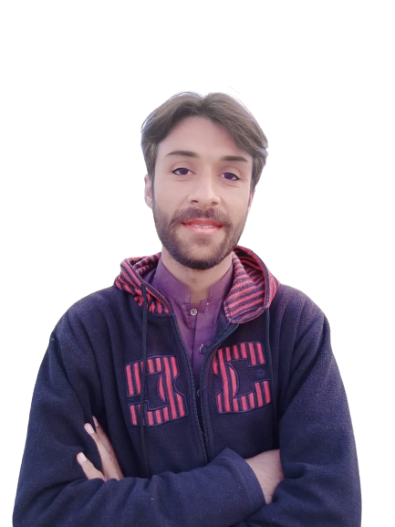
Complex Task Series
Problem Number 30

Slide 2
Problem Statement
Create a Web Application to Get a sentence from user to convert into uppercase. And also display length of sentence, total spaces to user.

Slide 3
Algorithm
Step1: Install Python Django Library
Step2: Create Project
Step3: Create Application And Include In Settings.Py File In Django Project
Step4: Create Template Directory In Application
Step5: Create Home HTML File In Application Template
Step6: Create a Form to get a sentence from user
Step7: Display sentence in uppercase
Step8: Display total spaces and total characters in a sentence
END

Slide 4
Assignment
Create a Web Application to Get a sentence from user to convert into uppercase. And also display length of sentence, total words, total spaces to user.

